Slide 1
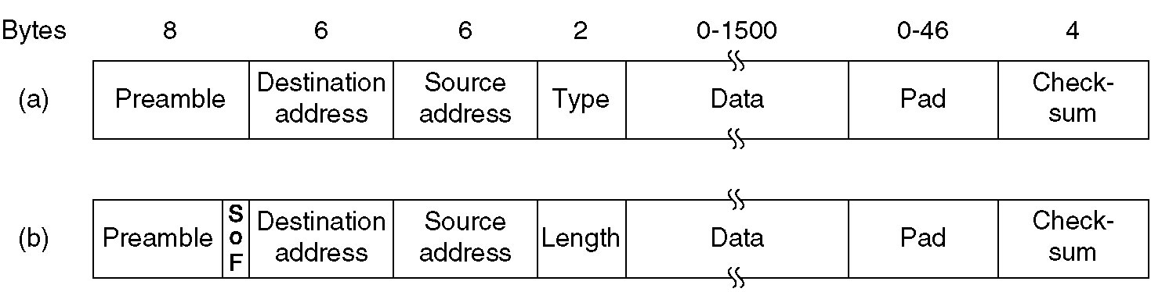
DIX Ethernet and IEEE 802.3 Frame Structures
Frame formats. (a) DIX Ethernet, (b) IEEE 802.3.

Slide 2
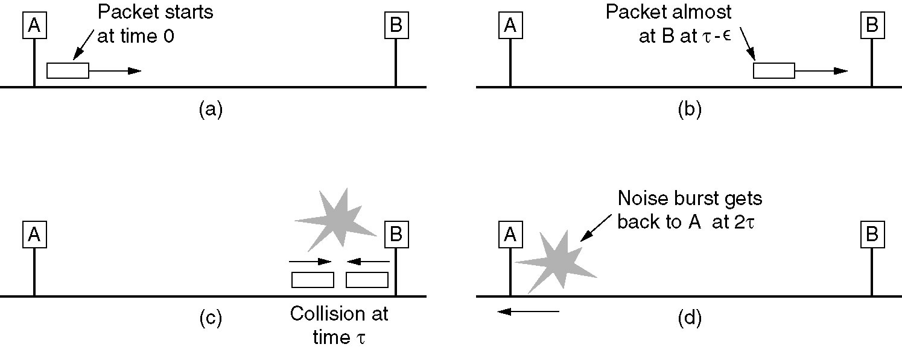
Minimum DIX Frame Size Rationale

Slide 3
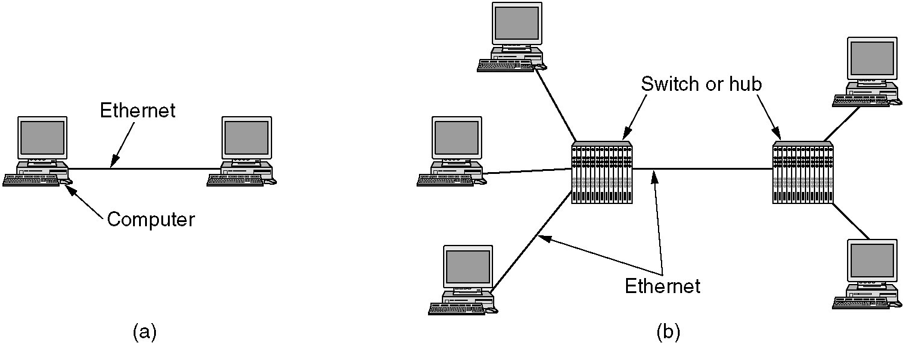
Gigabit Ethernet
(a) A two-station Ethernet. (b) A multistation Ethernet.

Slide 4
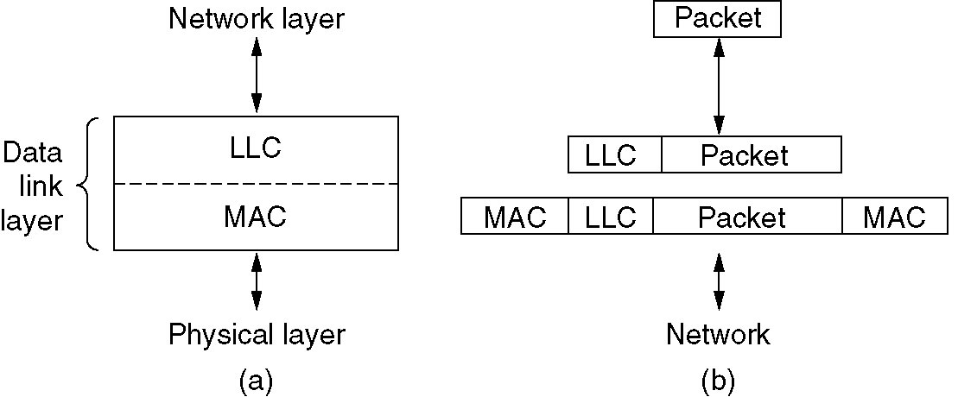
IEEE 802.2: Logical Link Control
(a) Position of LLC. (b) Protocol formats.

Slide 5
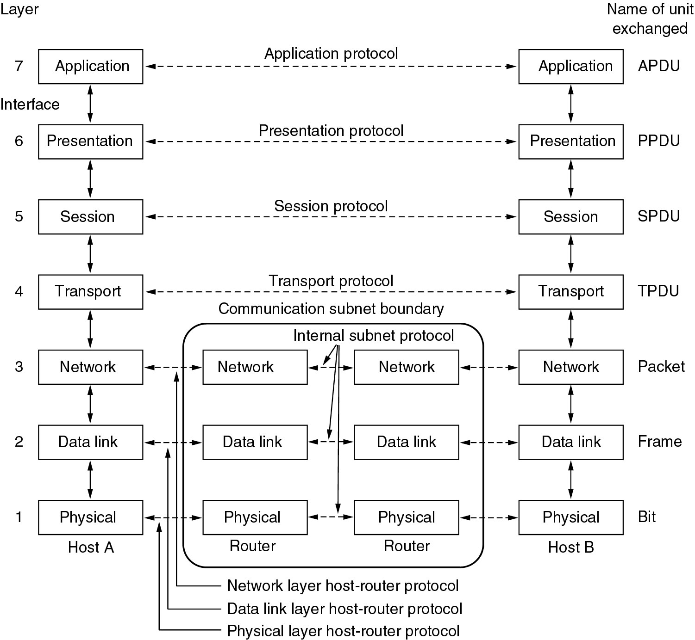
OSI Model

Slide 6
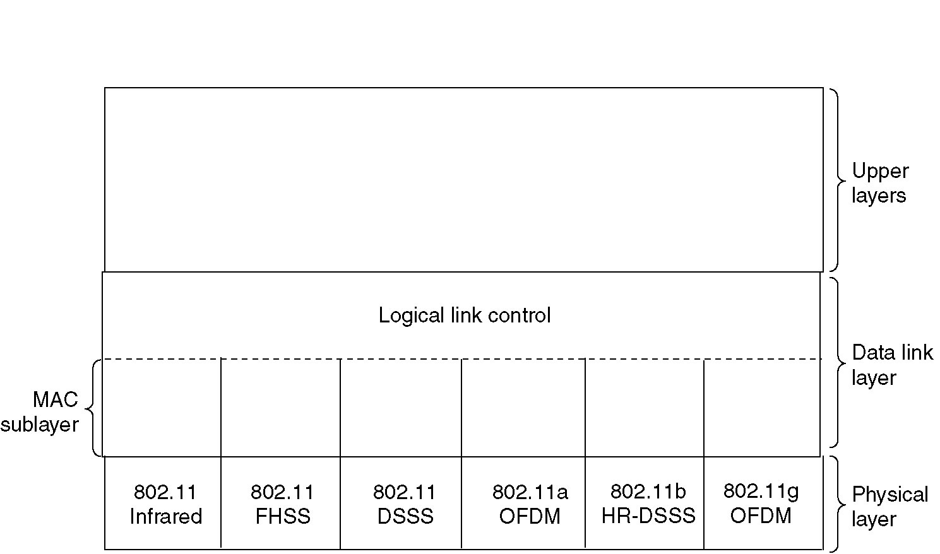
802.11 Protocol Stack
Part of the 802.11 protocol stack.

Slide 7
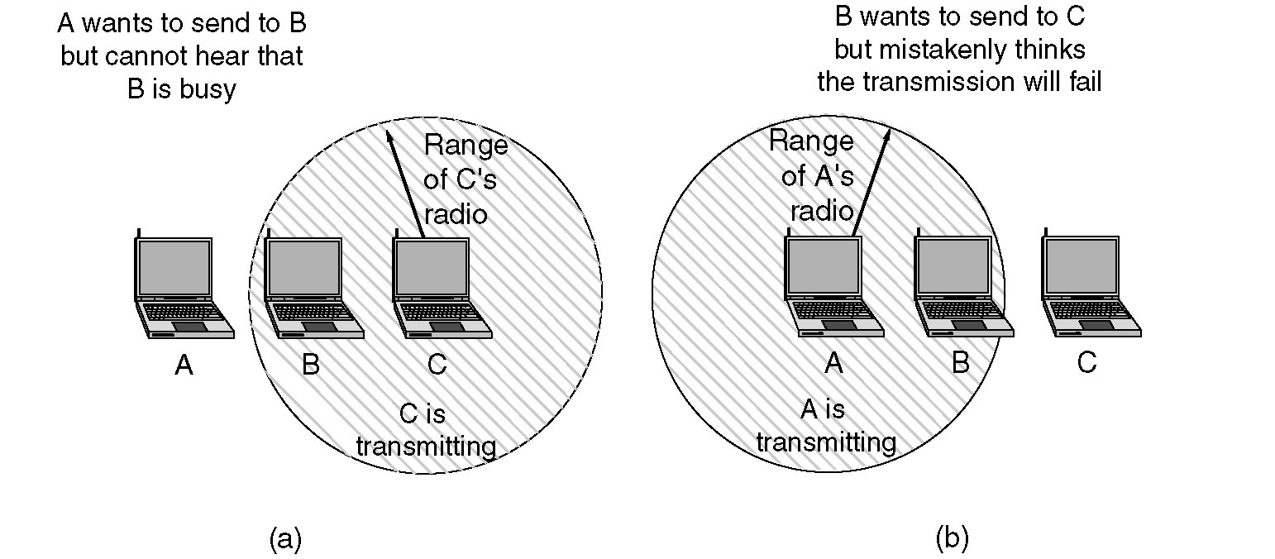
Hidden and Exposed Station Problems
(a) The hidden station problem
(b) The exposed station problem

Slide 8
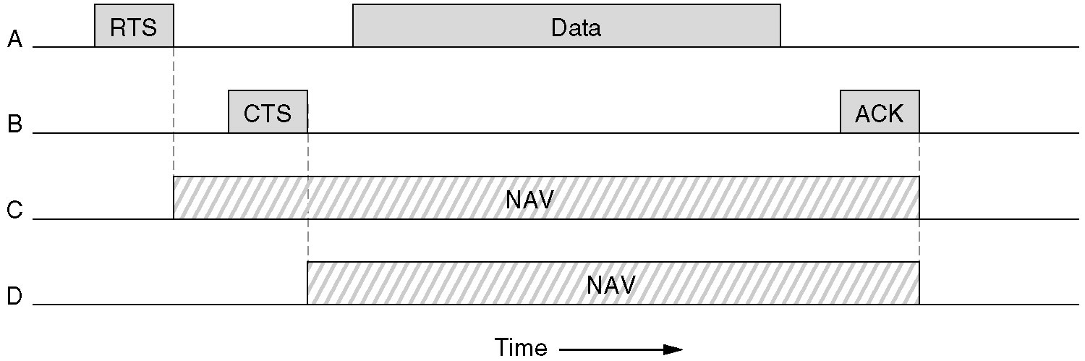
Network Allocation Vector

Slide 9
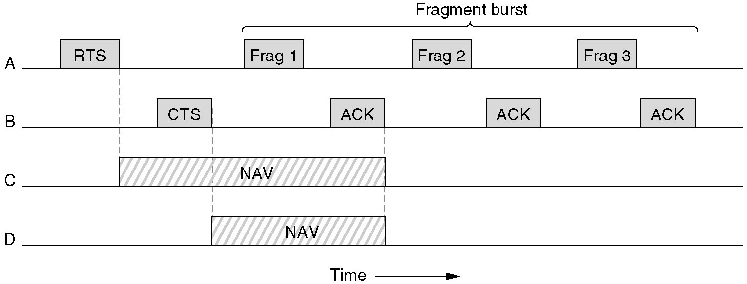
Fragment Burst Example

